Slide 1
Simple linear regression
Linear regression with one predictor variable

Slide 2
Simple Linear Regression
A statistical technique that uses a single, independent variable (X) to estimate a single dependent variable (Y),based on the equation for a line:
Y = b + mX

Slide 3
Types of Models
Deterministic Models
Probabilistic Models

Slide 4
Deterministic Models
1. Hypothesize Exact Relationships
2. Suitable When Prediction Error is Negligible
3. Example: Force is Exactly Mass Times Acceleration
F = m·a
© 1984-1994 T/Maker Co.

Slide 5
A deterministic (or functional) relationship

Slide 6
Other deterministic relationships
Circumference = π×diameter
Hooke’s Law: Y = α + βX, where Y = amount of stretch in spring, and X = applied weight.
Ohm’s Law: I = V/r, where V = voltage applied, r = resistance, and I = current.
Boyle’s Law: For a constant temperature, P = α/V, where P = pressure, α = constant for each gas, and V = volume of gas.

Slide 7
Probabilistic Models
1. Hypothesize 2 Components
Deterministic
Random Error
2. Example: Sales Volume is 10 Times Advertising Spending + Random Error
Y = 10X + ε
Random Error May Be Due to Factors Other Than Advertising

Slide 8
Relationship between state latitude and skin cancer mortality?
# State LAT MORT
1 Alabama 33.0 219
2 Arizona 34.5 160
3 Arkansas 35.0 170
4 California 37.5 182
5 Colorado 39.0 149
  
49 Wyoming 43.0 134
Mortality rate of white males due to malignant skin melanoma from 1950-1959.
LAT = degrees (north) latitude of center of state
MORT = mortality rate due to malignant skin melanoma per 10 million people

Slide 9
A statistical relationship
A relationship with some “trend”, but also with some “scatter.”

Slide 10
Other statistical relationships
Height and weight
Alcohol consumed and blood alcohol content
Vital lung capacity and pack-years of smoking
Driving speed and gas mileage

Slide 11
What is simple linear regression?
A way of evaluating the relationship between two continuous variables.
One variable is regarded as the predictor, explanatory, or independent variable (x).
Other variable is regarded as the response, outcome, or dependent variable (y).

Slide 12
Regression Models
1. Answer ‘What is the Relationship Between the Variables?’
2. Equation Used
1 Numerical Dependent (Response) Variable
What is to Be Predicted
1 or More Numerical or Categorical Independent (Explanatory) Variables
3. Used Mainly for Prediction & Estimation

Slide 13
Scatter Diagrams
A scatter plot is a graph that may be used to represent the relationship between two variables. Also referred to as a scatter diagram.

Slide 14
Two Variable Relationships
Y
X
(a) Linear

Slide 15
Two Variable Relationships
Y
X
(b) Linear

Slide 16
Two Variable Relationships
Y
X
(c) Curvilinear

Slide 17
Two Variable Relationships
Y
X
(d) Curvilinear

Slide 18
Two Variable Relationships
Y
X
(e) No Relationship

Slide 19
Types of Regression Models
1 Explanatory
Regression
2+ Explanatory
Models
Variable
Variables
Simple
Multiple
Non-
Non-
Linear
Linear
Linear
Linear

Slide 20
Linear Equations
High School Teacher
© 1984-1994 T/Maker Co.

Slide 21
Linear Regression Model
1. Relationship Between Variables is a Linear Function
Population Y-Intercept
Population Slope
Random Error
Y
=
β
+
β
X
+
ε
i
0
1
i
i
Dependent (Response) Variable (e.g., income)
Independent (Explanatory) Variable (e.g., education)

Slide 22
β₀ ≡ Mean response when x=0 (y-intercept)
β₁ ≡ Change in mean response when x increases by 1 unit (slope)
β₀, β₁ are unknown parameters (like μ)
β₀+β₁x ≡ Mean response when explanatory variable takes on the value x

Slide 23
The simple linear regression model has four assumptions:
Individual values of the error terms, ε_{i}, are statistically independent of one another. Which means ε_{i} and ε_{j} are uncorrelated.
The expected values of ε_{i} is zero. E(ε_{i} ) =0
The distributions of possible ε_{i} values have equal variances for all value of x. V(ε_{i} ) = σ2
The means of the dependent variable, for all specified values of the independent variable, x, can be connected by a straight line called the population regression model.

Slide 24
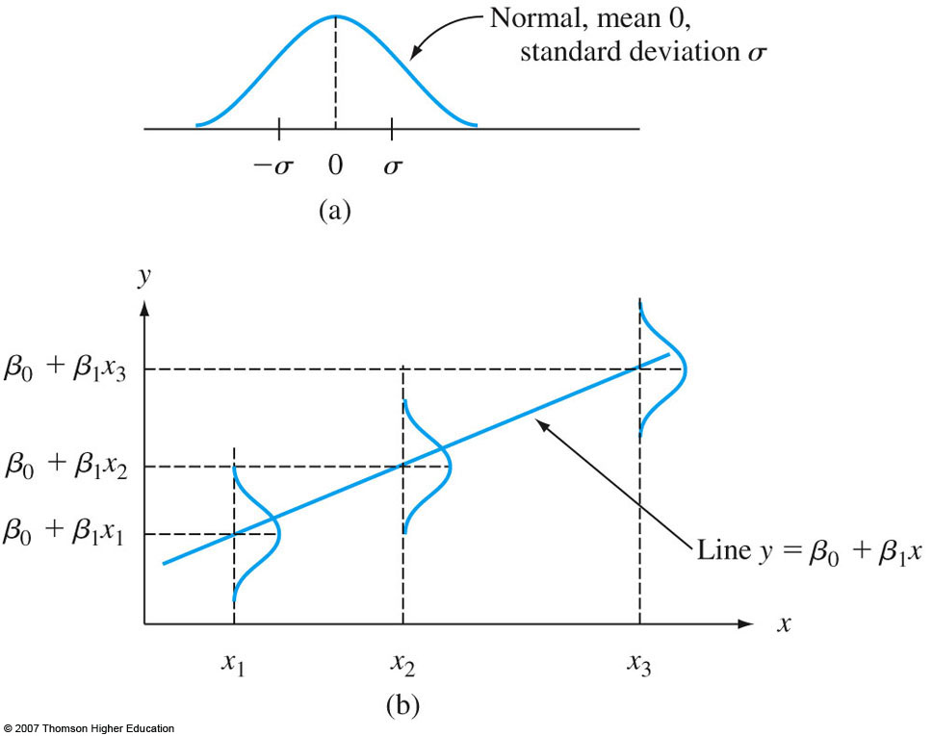

Slide 25
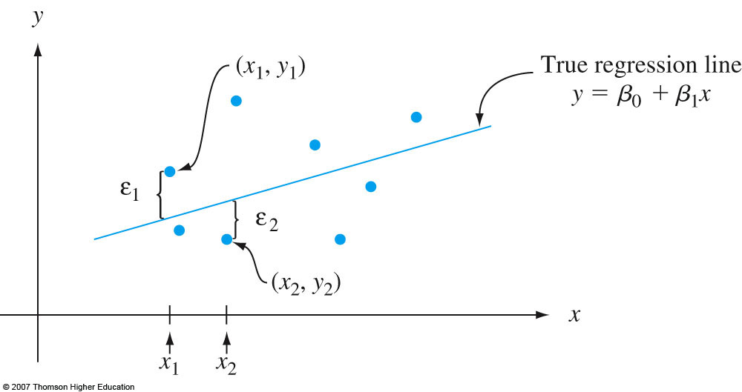

Slide 26
Notation
is the observed response for the i^{th} experimental unit.
is the predictor value for the i^{th} experimental unit.
is the predicted response (or fitted value) for the i^{th} experimental unit.
Equation of best fitting line:

Slide 27
Thinking Challenge
How would you draw a line through the points? How do you determine which line ‘fits best’?

Slide 28
Thinking Challenge
How would you draw a line through the points? How do you determine which line ‘fits best’?

Slide 29
Thinking Challenge
How would you draw a line through the points? How do you determine which line ‘fits best’?

Slide 30
Thinking Challenge
How would you draw a line through the points? How do you determine which line ‘fits best’?

Slide 31
Thinking Challenge
How would you draw a line through the points? How do you determine which line ‘fits best’?

Slide 32
Which is the “best fitting line”?

Slide 33
Prediction error (or residual error)
In using
to predict the actual response
we make a prediction error (or a residual error)
of size
A line that fits the data well will be one for which the n prediction errors are as small as possible in some overall sense.

Slide 34
The “least squares criterion”
Equation of best fitting line:
Choose the values b₀ and b₁ that minimize the sum of the squared prediction errors.
That is, find b₀ and b₁ that minimize:

Slide 35
The least squares regression line
Using calculus, minimize (take derivative with respect to b₀ and b₁, set to 0, and solve for b₀ and b₁):
and get the least squares estimates b₀ and b₁:

Slide 36
ESTIMATED REGRESSION MODEL
(SAMPLE MODEL)
where:
= Estimated, or predicted, y value
b₀ = Unbiased estimate of the regression intercept
b₁ = Unbiased estimate of the regression slope
x = Value of the independent variable

Slide 37
What do the “estimated regression coefficients” b₀ and b₁ tell us?
We can expect the mean response to increase or decrease by b₁ units for every unit increase in x.
If the “scope of the model” includes x = 0, then b₀ is the predicted mean response when x = 0. Otherwise, b₀ is not meaningful.

Slide 39
So, the estimated regression coefficients b₀ and b₁ tell us…
We predict the mean weight to increase by 6.14 pounds for every additional one-inch increase in height.
It is not meaningful to have a height of 0 inches. That is, the scope of the model does not include x = 0. So, here the intercept b₀ is not meaningful.

Slide 40
Properties of the Least-Squares Estimators and the Fitted Regression Model
are linear combinations of y_{i}
are unbiased estimators.

Slide 42
The Gauss-Markov Theorem:
are the best linear unbiased estimators (BLUE).

Slide 43
Some useful properties:
The sum of the residuals in any regression model that contains an intercept β₀ is always 0, i.e.
Regression line always passes through the centroid point of data,

Slide 44
SS_{T}: the corrected sum of squares of the observations. It measures the total variability in the observations.
SS_{Res}: the residual or error sum of squares
The residual variation left unexplained by the regression line.
SS_{R}: the regression or model sum of squares
The amount of variability in the observations accounted for by the regression line
SS_{T} = SS_{R} + SS_{Res(Error)}

Slide 45
We define:
Note: total sum of squares (SST)
Regression sum of squares (SSR)
Error sum of squares (SSE)
is called the coefficient of determination

Slide 46
Estimator of σ²
Residual sum of squares:

Slide 47
Since ,
the unbiased estimator of σ² is
MS_{E} is called the residual mean square.

Slide 48
The simple linear regression model
The mean of the responses, E(Y_{i}), is a linear function of the x_{i}.
The errors, ε_{i}, and hence the responses Y_{i}, are independent.
The errors, ε_{i}, and hence the responses Y_{i}, are normally distributed.
The errors, ε_{i}, and hence the responses Y_{i}, have equal variances (σ²) for all x values.

Slide 49
An example
Age and cholesterol
levels in 18 individuals
ID Age Chol (mg/ml)
1 46 3.5
2 20 1.9
3 52 4.0
4 30 2.6
5 57 4.5
6 25 3.0
7 28 2.9
8 36 3.8
9 22 2.1
10 43 3.8
11 57 4.1
12 33 3.0
13 22 2.5
14 63 4.6
15 40 3.2
16 48 4.2
17 28 2.3
18 49 4.0

Slide 50
Read data into R
id <- seq(1:18)
age <- c(46, 20, 52, 30, 57, 25, 28, 36, 22,
43, 57, 33, 22, 63, 40, 48, 28, 49)
chol <- c(3.5, 1.9, 4.0, 2.6, 4.5, 3.0, 2.9, 3.8, 2.1,
3.8, 4.1, 3.0, 2.5, 4.6, 3.2, 4.2, 2.3, 4.0)
plot(chol ~ age) or plot(age,chol)
par(bg='black', fg='white', col.axis='white', col.lab='white‘,col.main=“white”, las=1, mar=0.1+c(5,5,2,2))
plot(chol~age, xlab=”age”,ylab=”chol”,main=”Scatter plot of”, pch=23, bg=”red”,cex=2, lwd=2)

Slide 52
Regression analysis using R
id <- seq(1:18)
age <- c(46, 20, 52, 30, 57, 25, 28, 36, 22,
43, 57, 33, 22, 63, 40, 48, 28, 49)
chol <- c(3.5, 1.9, 4.0, 2.6, 4.5, 3.0, 2.9, 3.8, 2.1,
3.8, 4.1, 3.0, 2.5, 4.6, 3.2, 4.2, 2.3, 4.0)
#Fit linear regression model
regmodel <- lm(chol ~ age)
summary(regmodel)

Slide 53
Results of R analysis
> summary(regmodel)
Call:
lm(formula = chol ~ age)
Residuals:
Min 1Q Median 3Q Max
-0.40729 -0.24133 -0.04522 0.17939 0.63040
Coefficients:
Estimate Std. Error t value Pr(>|t|)
(Intercept) 1.089218 0.221466 4.918 0.000154 ***
age 0.057788 0.005399 10.704 1.06e-08 ***
---
Signif. codes: 0 '***' 0.001 '**' 0.01 '*' 0.05 '.' 0.1 ' ' 1
Residual standard error: 0.3027 on 16 degrees of freedom
Multiple R-Squared: 0.8775, Adjusted R-squared: 0.8698
F-statistic: 114.6 on 1 and 16 DF, p-value: 1.058e-08

Slide 54
ANOVA result
> anova(regmodel)
Analysis of Variance Table
Response: chol
Df Sum Sq Mean Sq F value Pr(>F)
age 1 10.4944 10.4944 114.57 1.058e-08 ***
Residuals 16 1.4656 0.0916
---
Signif. codes: 0 '***' 0.001 '**' 0.01 '*' 0.05 '.' 0.1 ' ' 1

Slide 55
Fit=Regmodel$fitted.values
Res=Regmodel$residuals

Slide 56
Recall the “sample variance”
The sample variance
estimates σ², the variance of the one population.

Slide 57
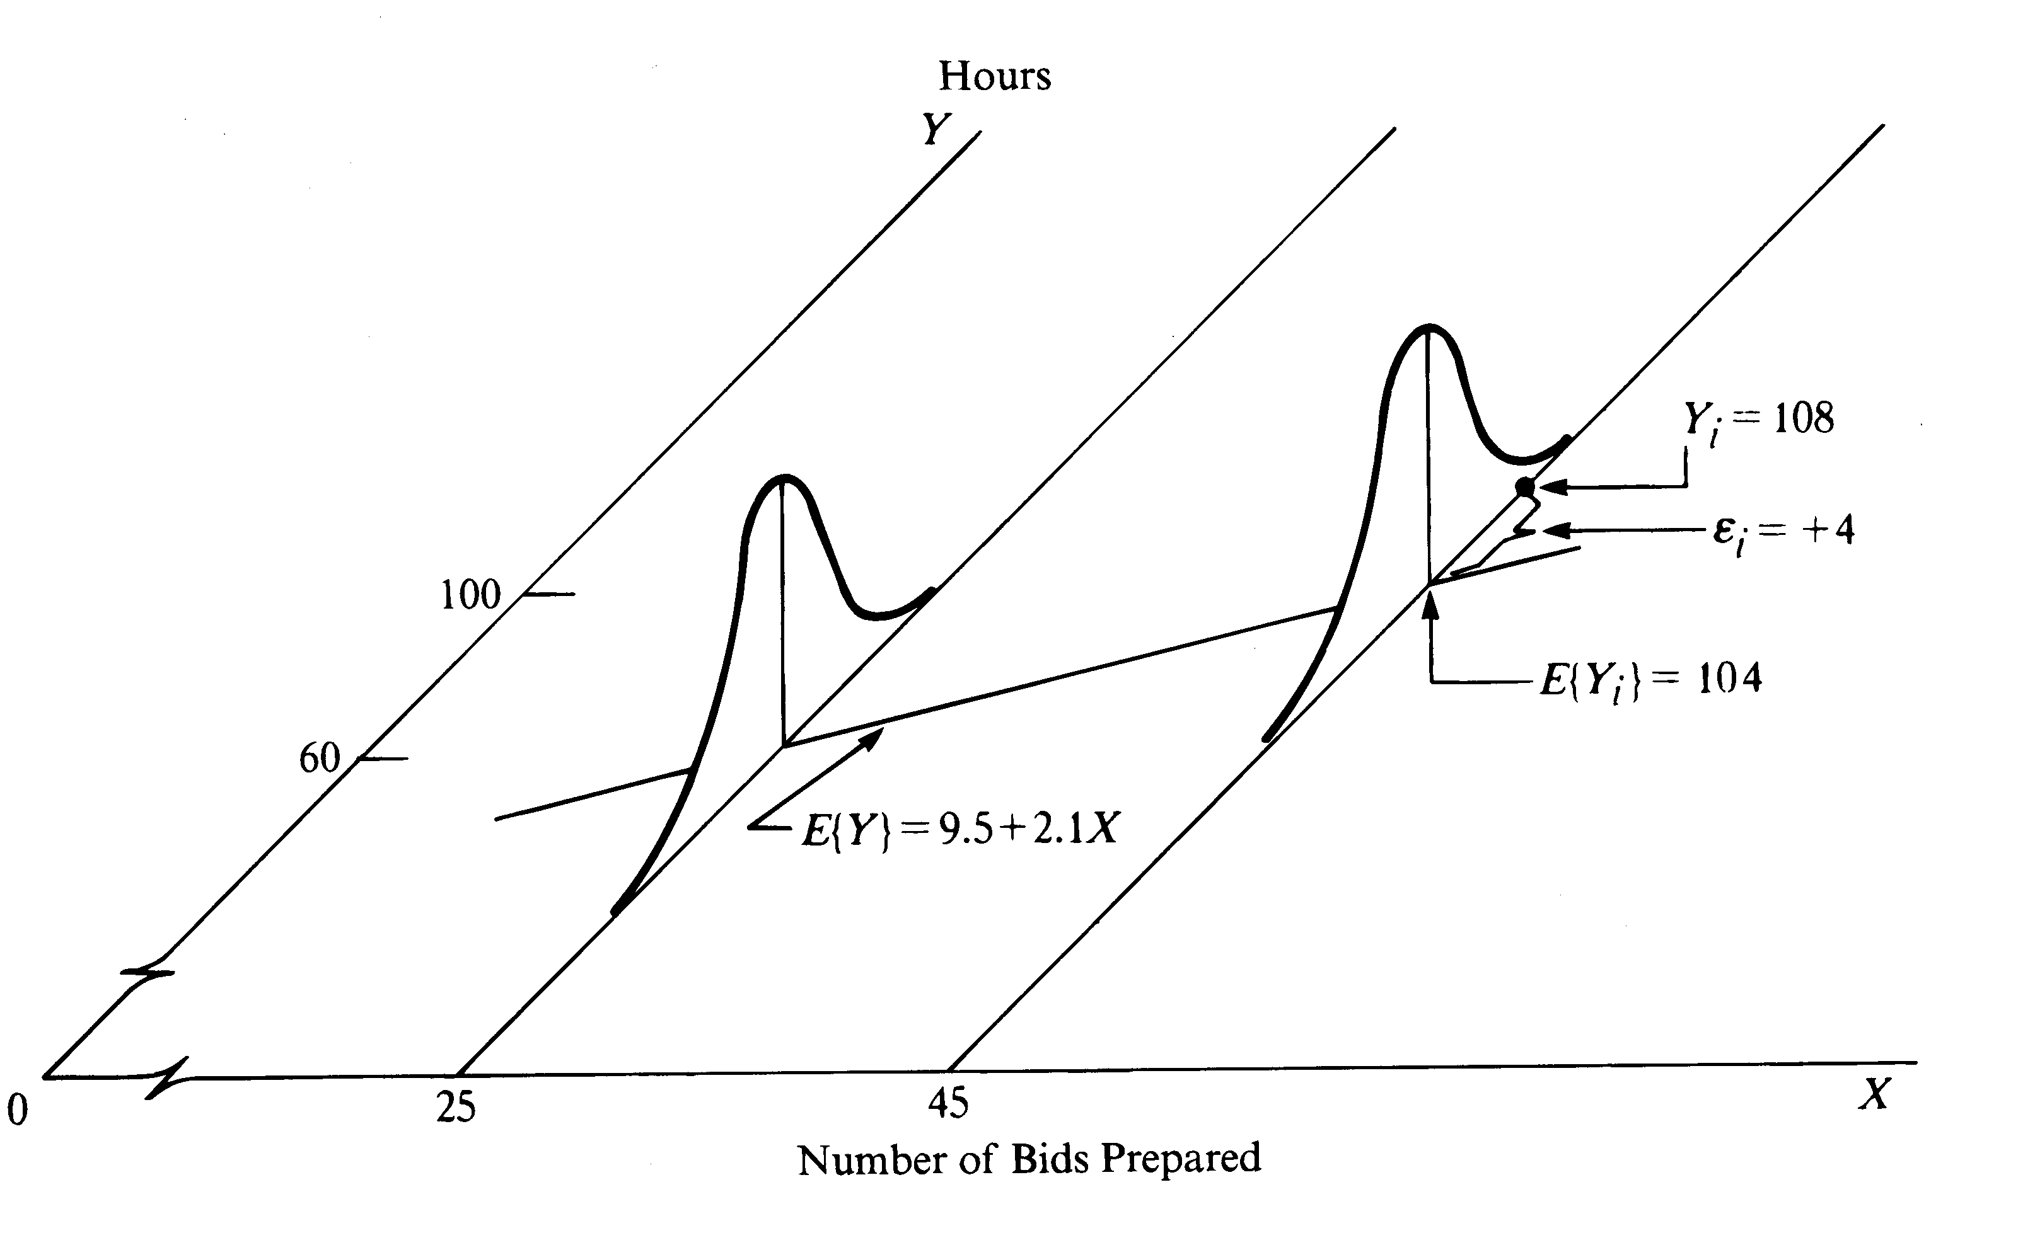
Estimating σ² in regression setting
The mean square error
estimates σ², the common variance of the many populations.

